Slide 1
Morphology
Set theory is the mathematical basis for morphology. Sets in Euclidic space E² (or rather Z² : the set of pairs of integers) describe the object pixels in a binary image, either the black or white pixels. Z³ sets are used for describing the 3-D or time series of 2-D binary images as well as 2-D gray level images.
Elementary operations on A: a subset of E^{n} with n-tuple elements: a=(a₁,a₂,...a_{n})
Translation over d ∈E^{n}: A_{d} = { x∈E^{n} | x = a + d, for some a∈A}
Complement (negation): A^{c} = { x∈E^{n} | x ∉A }
Reflection (transposition): A^{r} = { x∈E^{n} | x = -a, for some a∈A}
Intersection of A and B: A ∩ B = {x∈E^{n} | x∈A and x∈B}
Union of A and B: A ∪ B = {x∈E^{n} | x∈A or x∈B}
Difference between A and B: A-B = {x∈E^{n} | x∈A and x∉B}
= A ∩ B^{c}
2007
Theo Schouten

Slide 2
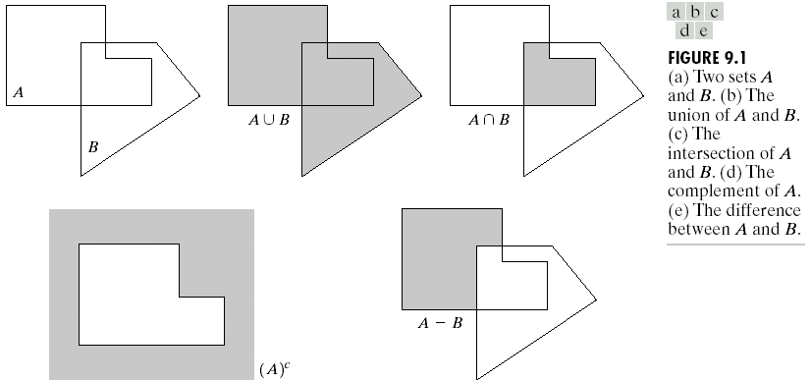
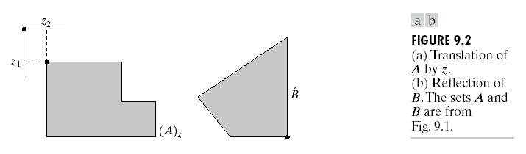
Basic set operations
2007
Theo Schouten

Slide 3
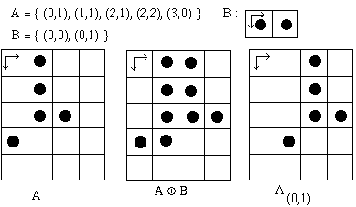
Dilation
The dilation operator on sets A and B are defined by:
A ⊕ B = { c∈E^{n} | c = a + b, for some a∈A, b∈ B }
= ∪_{[b ∈ B]} A_{b}
= { x | (B^{r}_{x} ∩ A ) ≠ ∅ }
A is normally the image, while B is often a smaller structuring element.
2007
Theo Schouten

Slide 4


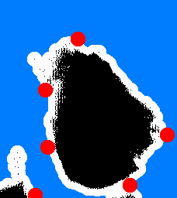
Example dilation
Dilation with a discrete "disk", the origin being inside of it, gives an isotrope "swelling" or "expansion" of the image.
Note that here the white pixels have been chosen as the object pixels.
This implementation is based on the third definition of dilation. Black indicates the original pixels and white the pixels that were added in. In red are some place of the movement of B^{r}_{x} .
2007
Theo Schouten

Slide 5
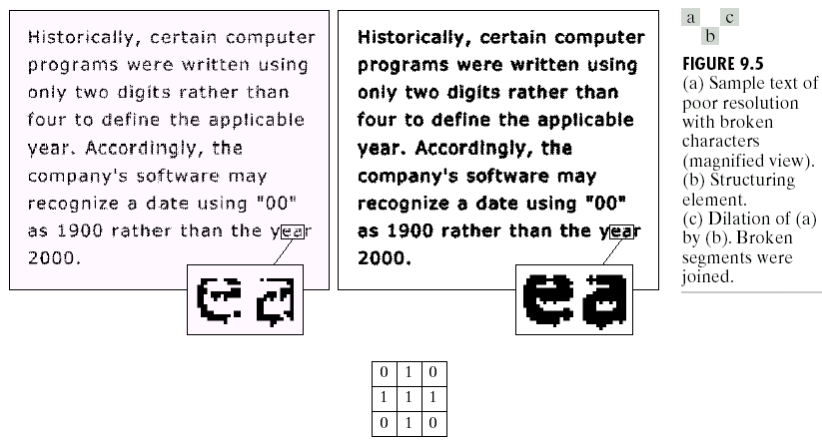
another example dilation
2007
Theo Schouten

Slide 6
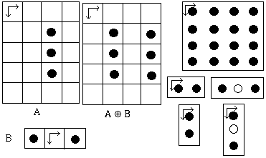
Dilation properties
Dilation is communitative and associative:
A ⊕ B = B ⊕ A
A ⊕ (B ⊕ C) = (A ⊕ B) ⊕ C
This is used in software and hardware implementations to save on operations; if B and C each have N elements then B ⊕ C can have N² elements.
On the right you can see that a dilation using a 4 by 4 square with 16 pixels, can be done with 4 consecutive dilations each with structure elements of 2 pixels.
To the left you can see that if the origin is not in B, then it is possible that A ⊕ B has no pixels in common with A.
A_{d} ⊕ B = (A ⊕ B) _{d} and A_{d} ⊕ B_{-d} = A ⊕ B (hardware implementations)
(A∪B) ⊕ C = (A ⊕ C) ∪ (B ⊕ C) and A ⊕ (B ∪ C) = (A ⊕ B) ∪ (A ⊕ C)
2007
Theo Schouten

Slide 7
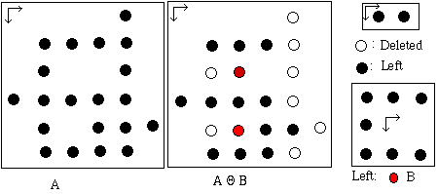
Erosion
A Θ B = { c ∈ E^{n} | (c + b) ∈ A for every b ∈ B }
= { c ∈ E^{n} | B_{c} ⊆ A }
= { c ∈ E^{n} | for every b ∈ B there is an a ∈ A such that c = a-b}
= ∩ _{[b ∈ B]} A_{-b}
Erosion is not commutative nor is it equal to the difference of the sets.
(0,0) ∈ B ⇒ (A Θ B) ⊆ A
thus resulting in "shrinking" of the original image
2007
Theo Schouten

Slide 8
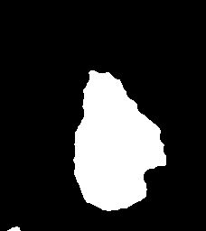
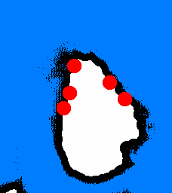
Example erosion
A_{d} Θ B = (A Θ B)_{d}
A Θ B_{d} = (A Θ B)_{-d}
A Θ (B ∪ C) = (A Θ B) ∩ (A Θ C)
(A Θ B)^{c} = A^{c} ⊕ B^{r} (erosion-dilation duality)
(A ∪ B)^{c} = A^{c} ∩ B^{c} (DeMorgan's law)
A Θ (B ⊕ C) = (A Θ B) Θ C (replace erosion by 2 smaller ones)
2007
Theo Schouten

Slide 9
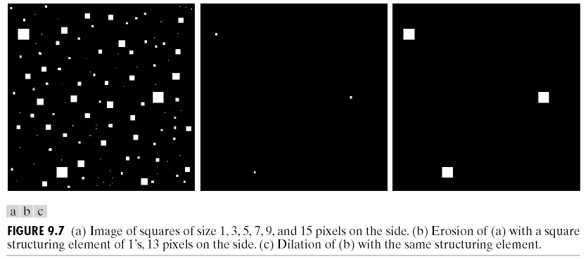
example erosion + dilation
2007
Theo Schouten

Slide 10
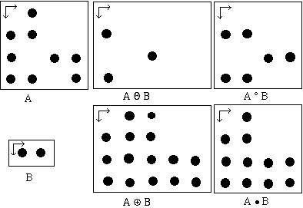
Opening and Closing
opening: AοK = (A Θ K) ⊕ K
closing: A•K = (A ⊕ K) Θ K
AοB = ∪ [ {y | B_{y} ⊆ A ] B_{y} or
{ x ∈ A | there is a y, x ∈ B_{y} and B_{y} ⊆ A}
representing the union of translations of B which are contained in A
A • B = ∪ [ [ { y | B_{y}^{r} ⊆ A^{c} } ] B_{y}^{r} ] ^{c}
representing the complement of the union of all translations
Duality of opening and closing:
(A • K)^{c} = A^{c} ο K^{r}
Idempotent:
AοK = (AοK) οK
A•K = (A•K ) •K
2007
Theo Schouten

Slide 11
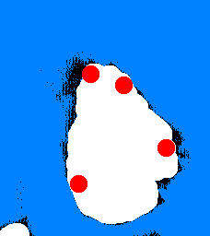
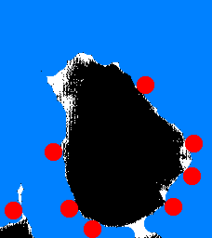
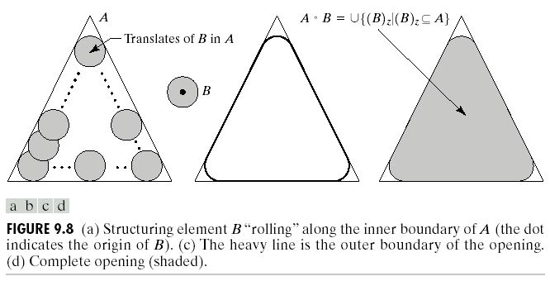
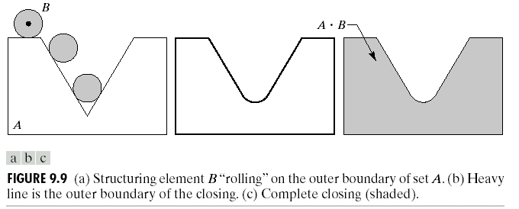
Example opening and closing
Left: the open operation
The structure element moves along the inside of the object and the black pixels disappear.
Right: the close operation
The structure element moves along the outside of the object and the white pixels are added.
2007
Theo Schouten

Slide 12
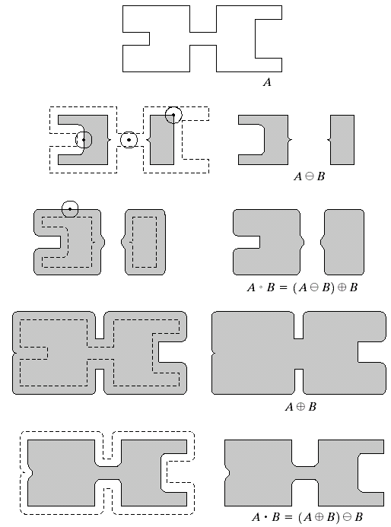
Another example
opening with a disk structure element:
breaks thin connections within an object
eliminates small islands and sharp protrusions
closing with a disk structure element:
fills thin connections within an object
eliminates small holes and fills dents in contours
fills small gaps in parts of an object
2007
Theo Schouten

Slide 13
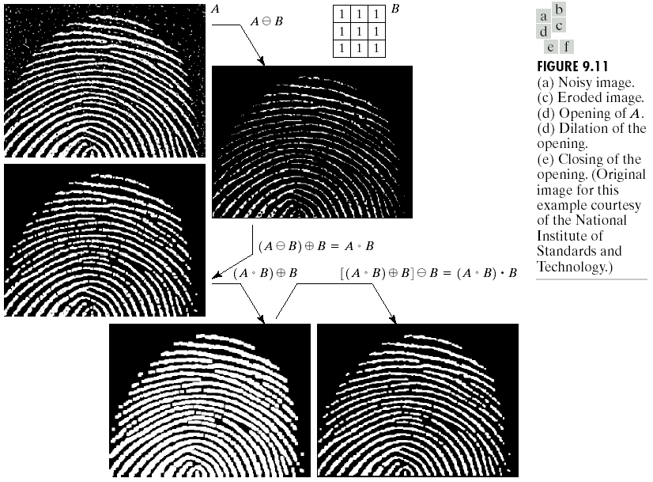
Real image example
2007
Theo Schouten

Slide 14




Hit-or-Miss transformation
The goal of the "hit-miss" operation is to find pixels x, for which B¹_{x} is in A (“hit”) and where no pixel in B²_{x} is in A (“miss”), thus B²_{x} is in A^{c}.
The definition of the "hit-miss" operation is:
A⊗B = { x ∈ E^{n} | B¹_{x} ⊆ A and B²_{x} ⊆ A^{c}}
It can be shown that:
A⊗B = ( A Θ B¹ ) ∩ ( A^{c} Θ B² ) = ( A Θ B¹ ) - ( A Θ B^{2r} )
Searching for white pixels,
that do not have 4-connected
neighboring pixels.
B¹
Original image (white pixels)
Erosion with B1
B²
Complement
Erosion with B2
2007
Theo Schouten

Slide 15
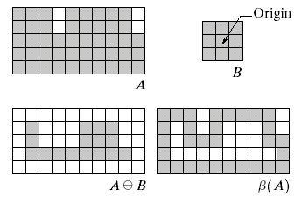
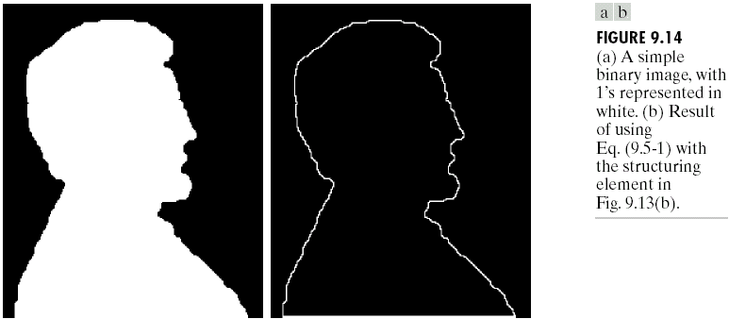
Boundary extraction
β_{B}(A) = A - (A Θ B)
2007
Theo Schouten

Slide 16



Other operations
Other, more complicated operations:
  region filling, connected components, convex hull, thinning, thickening, skeletons, pruning
L. Vincent (Signal Processing 22,1991,3-23) gives an efficient algorithm for the implementation of morphological operations with random structure elements, assuming a chain code encoding of the binary objects.
Thinning with different structure elements
2007
Theo Schouten

Slide 17
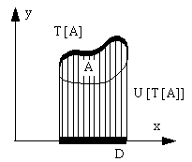
Gray level images
We use sets in E^{N}. The first (N-1) coordinates form the spatial domain and the last coordinate is for the surface. For gray level images N=3, the first two coordinates of an element in a set are the (x,y) in the image and the third is the gray level. Concepts such as top or top-surface of a set and the shadow (umbra) of a surface are used in the definitions of the operations.
f ⊕ k = T [ U[f] ⊕ U[k] ] thus (f ⊕ k)(x) = max { z ∈ K, x-z ∈ F | f(x-z) + k(z) }
f Θ k = T [ U[f] Θ U[k] ] thus (f Θ k)(x) = min { z ∈ K, x+z ∈ F | f(x+z) - k(z) }
The properties of gray level dilation and erosion are equivalent to those of binary operations.
2007
Theo Schouten

Slide 18
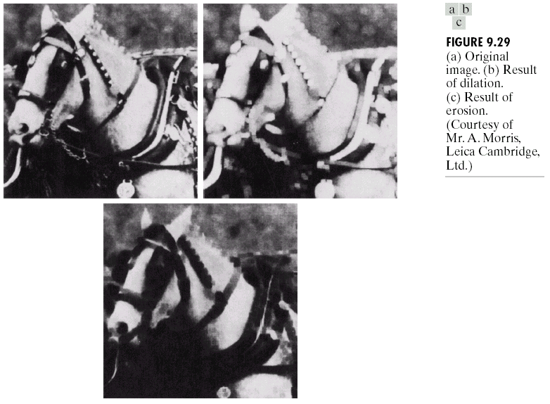
Example dilation, erosion
2007
Theo Schouten

Slide 19
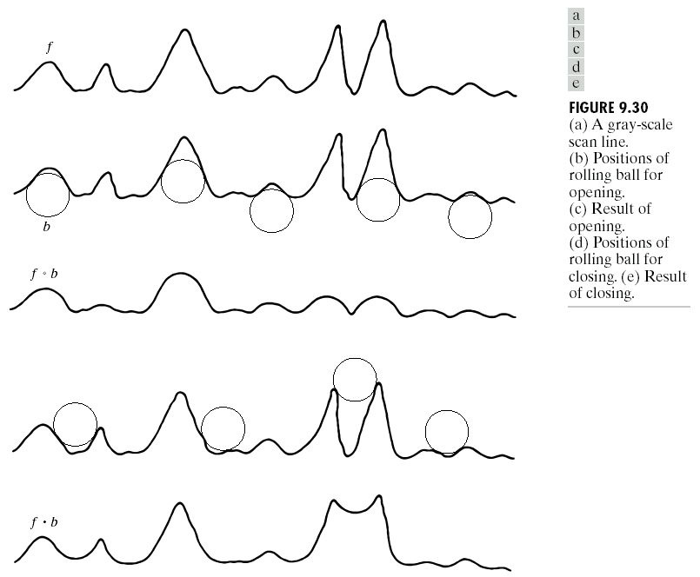
Gray opening, closing
2007
Theo Schouten

Slide 20
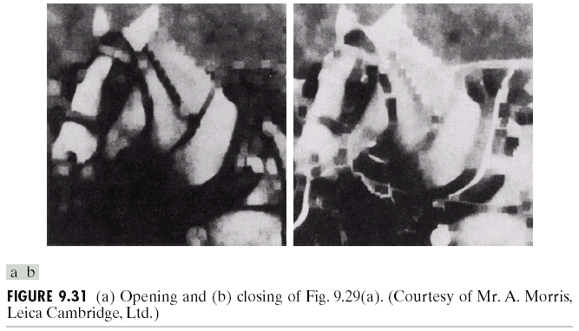

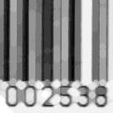

Example opening and closing
To the far left is the original image, in the center the opening of it with a disk with radius 3 as the structure element. All the thin white bands have disappeared, only the broad one remains. To the right the closing, all the valleys where the structure element does not fit have been filled, only the three broad black bands remain.
2007
Theo Schouten

Slide 21
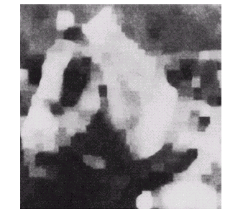
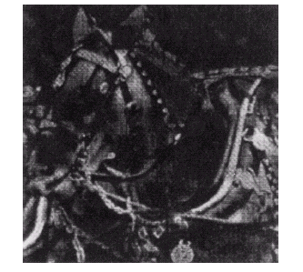
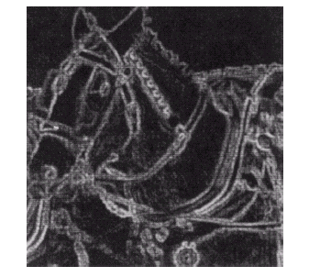
Smoothing, gradient, top-hat
Smoothing:
s = (f ο b) • b
Top-hat:
h = f-(f ο b)
Gradient:
g = (f ⊕ b) -(f Θ b)
2007
Theo Schouten

